Slide 1


NRT Pipeline Solutions
Pipeline Modernization Overview
Presented by [Presenter Name]
Transforming data processes for efficiency and growth.

Slide 2
Legacy Workflow Challenges
Understanding the limitations of the existing pipeline processes
Manual Scheduling Issues
Maintenance Complexity
The current pipeline relies heavily on manual scheduling, making it prone to delays and human error. This lack of automation results in inefficiencies and complicates dependency management, ultimately hindering the workflow’s responsiveness to changes and urgent data requirements.
The legacy system's multiple codebases contribute to significant maintenance challenges. Scaling and auditing become difficult due to the fragmented architecture, which not only increases operational costs but also impedes the ability to implement timely updates and improvements effectively.
2

Slide 3

Modern Workflow Enhancements
Config-driven Controls
Incremental Loads
Glue Integration
Features are easily toggled, enhancing data quality without hardcoding changes.
Supports real-time analytics, ensuring timely data availability for decision-making.
Centralizes all transformations, improving maintainability and reducing complexity.
3

Slide 4
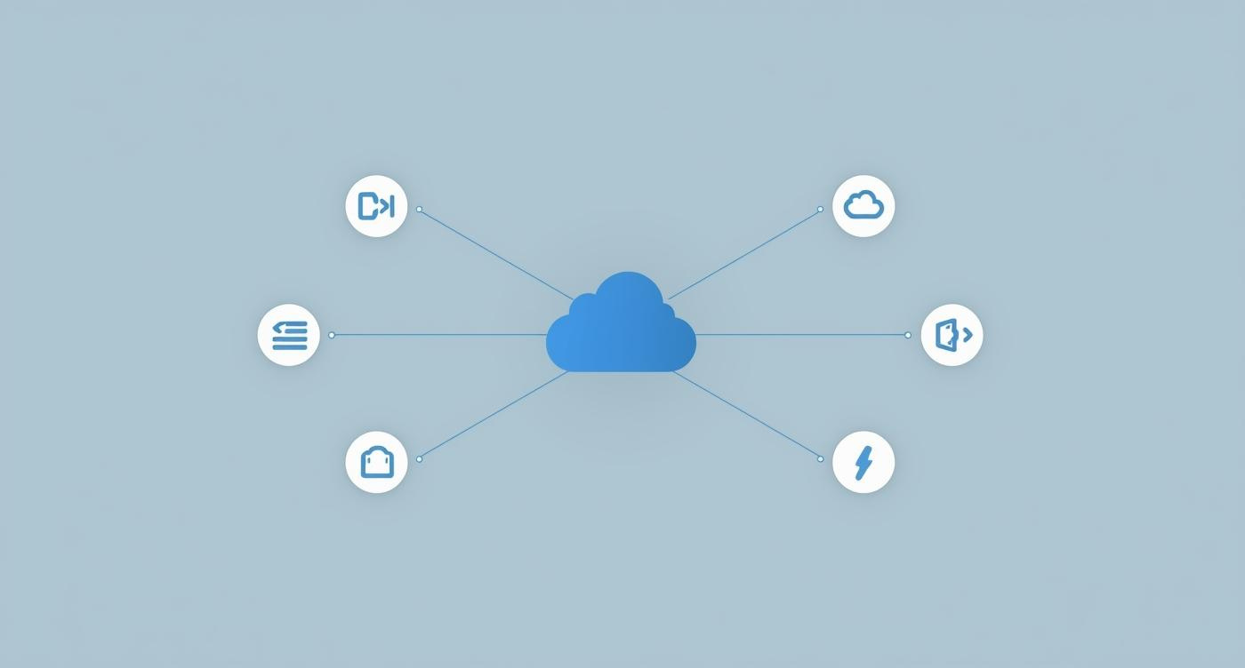
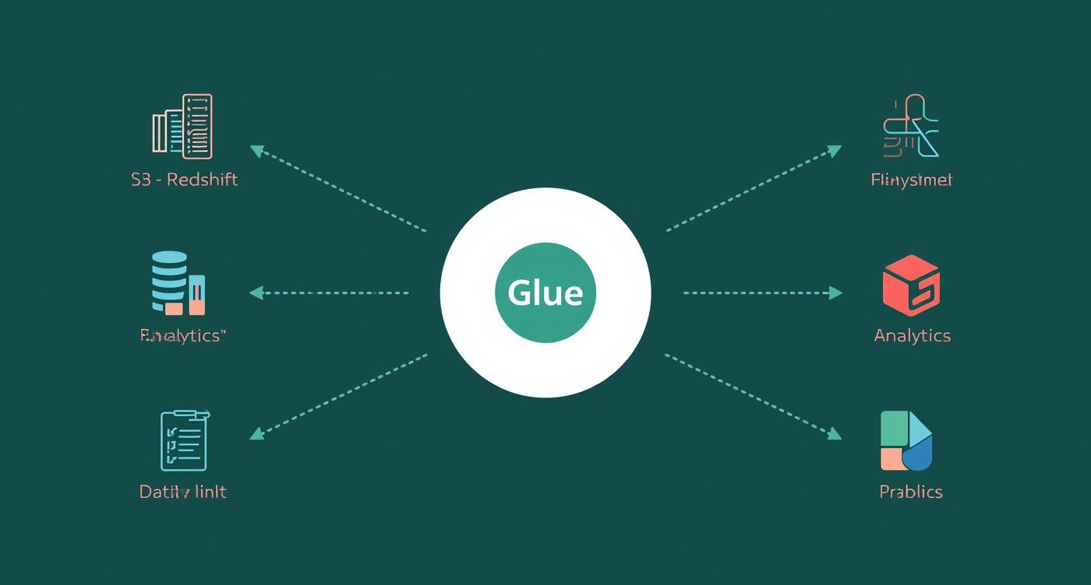
Key Differentiators: Legacy vs Modern Workflow
Multiple Lambdas
Single Glue Job
Complex orchestration with multiple Lambda functions creates overhead and potential delays.
Unified Glue job simplifies orchestration while ensuring efficient data processing.
4

Slide 5
Business Benefits of Modernization
Faster Data Loads
Reduced Complexity
Higher Data Quality
Enhanced speed and reliability ensure timely access to critical business information.
Simplified architecture minimizes maintenance efforts, allowing focus on core applications.
Improved auditability and versioning lead to greater confidence in data-driven decision making.
5

Slide 6
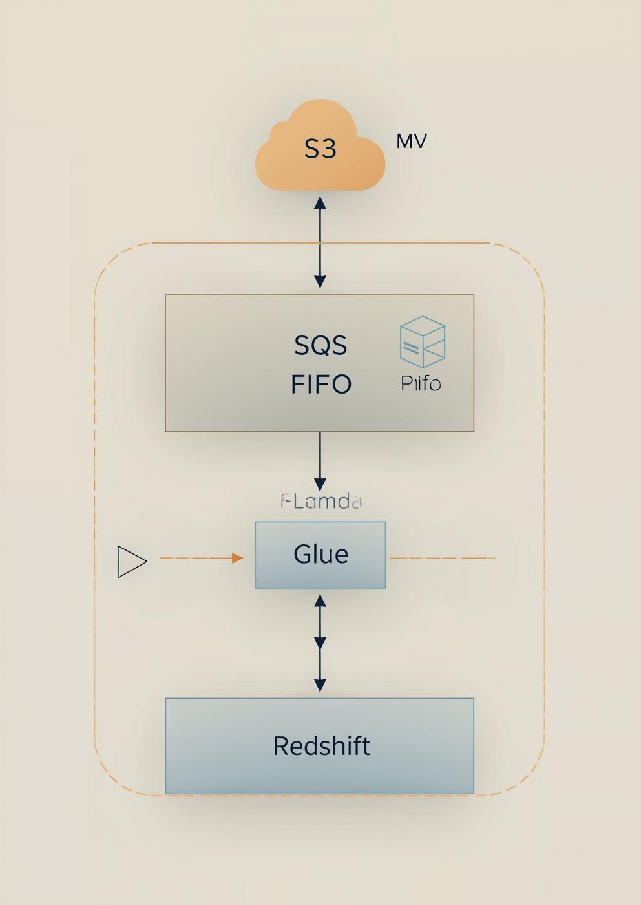
Workflow Overview
Streamlined Data Processing Architecture for Enhanced Performance and Scalability
Visualizing the transition from legacy to modern workflows showcases improved data handling and processing efficiencies.
The architecture diagram illustrates the seamless flow of data through various components, emphasizing the benefits of event-driven processing. This approach resolves legacy issues, providing immediate, automated, and accurate data handling to support advanced analytics and future business needs.
6

Slide 7
Get in Touch with Us
Email Us
hello@reallygreatsite.com
Follow Us
@reallygreatsite
Call Us
123-456-7890
NRT Solutions

